Slide 1



Pull
Commit
Push
File
Local Repository
On PC
Remote Repository
On the Cloud

Slide 2
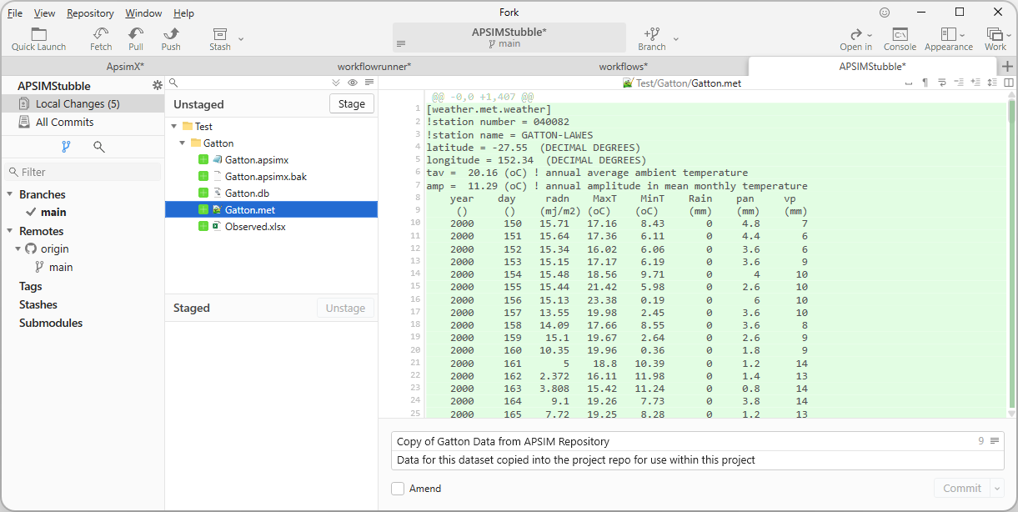
1
2

Slide 3
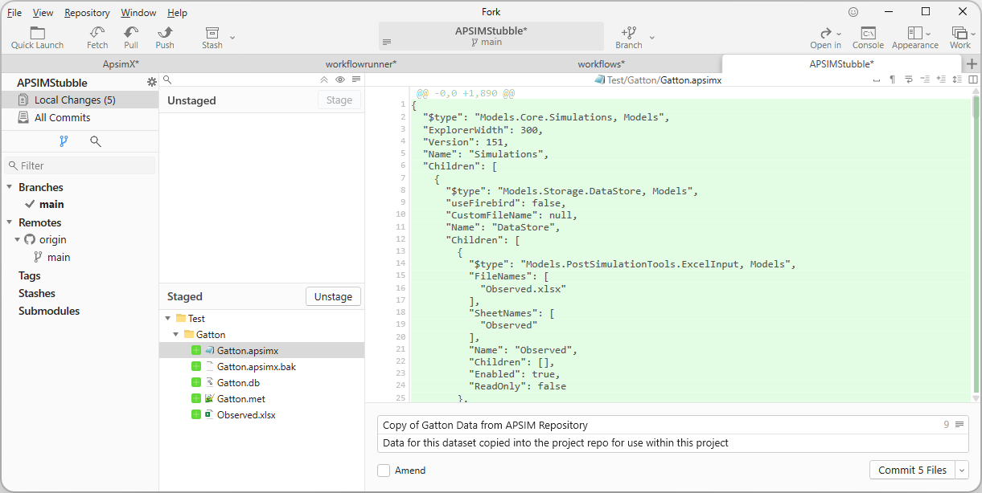
3
4

Slide 4
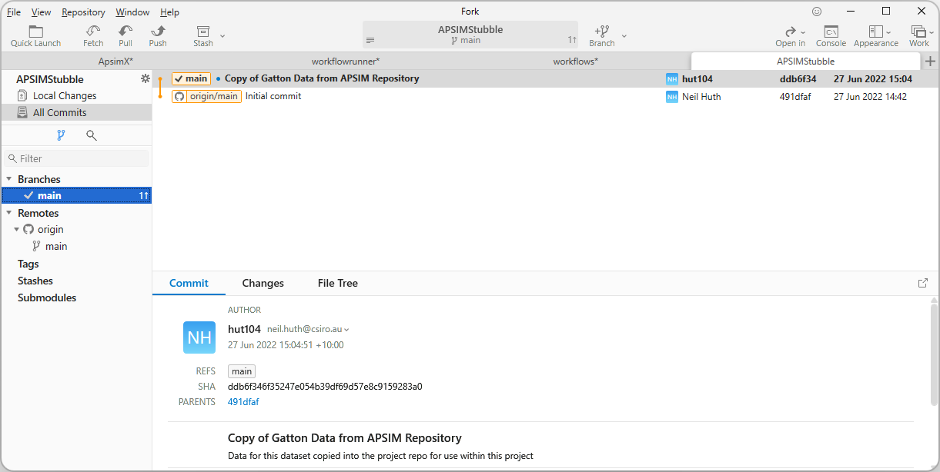

Slide 5
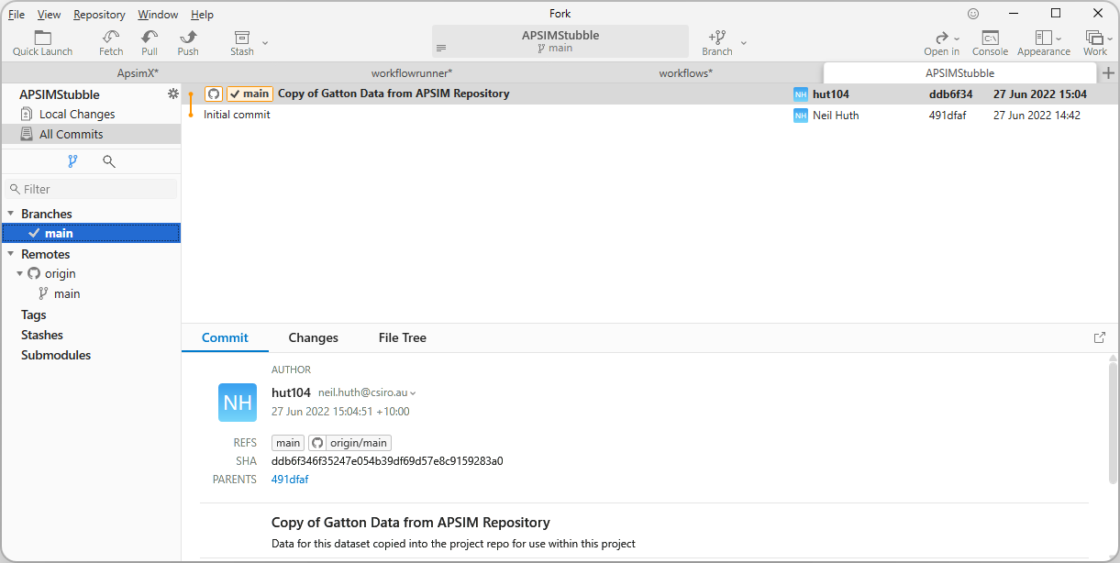

Slide 6
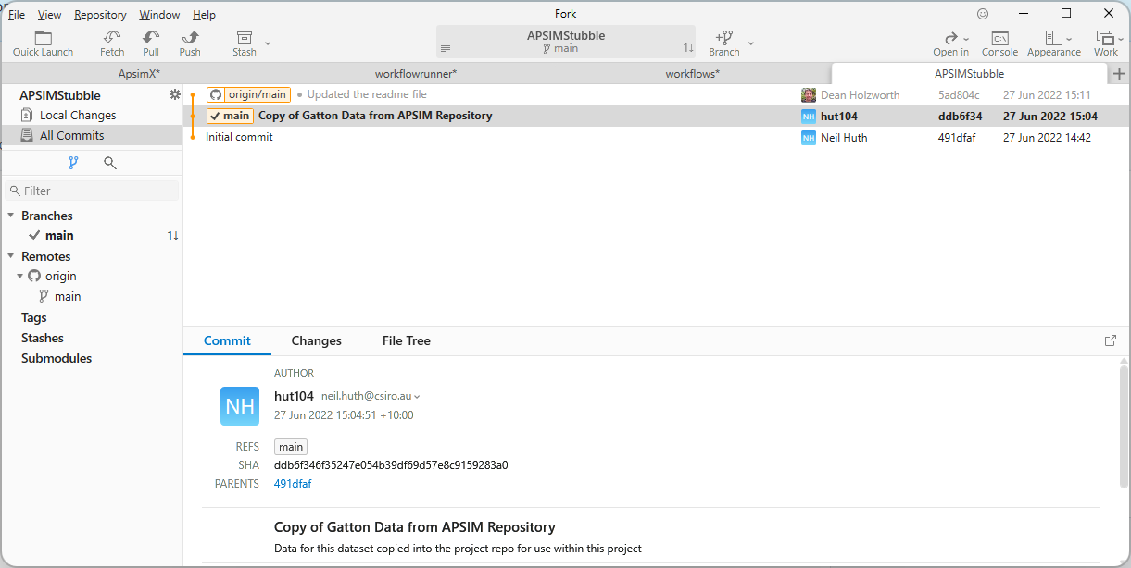

Slide 7
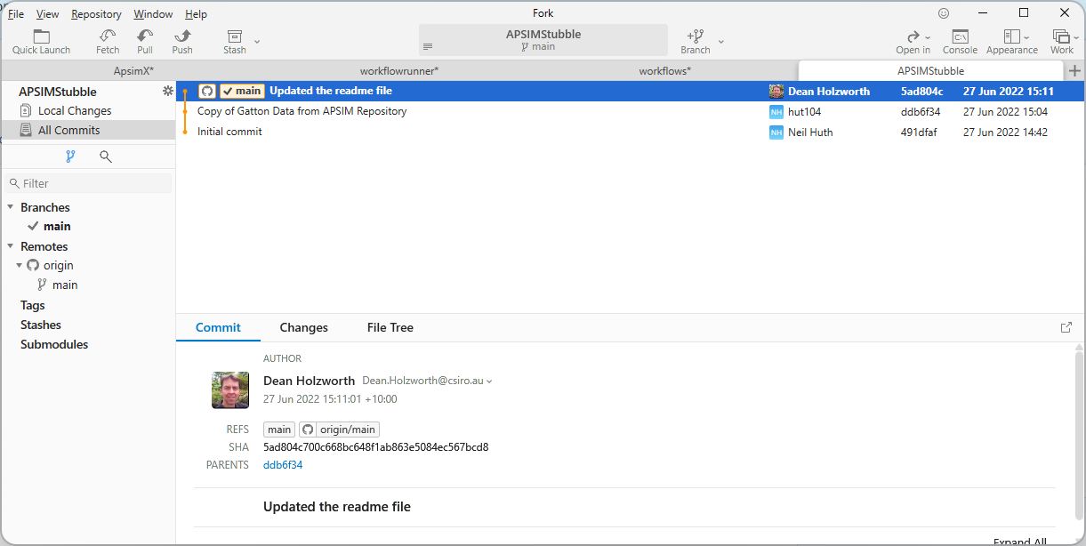

Slide 8
